Slide 1
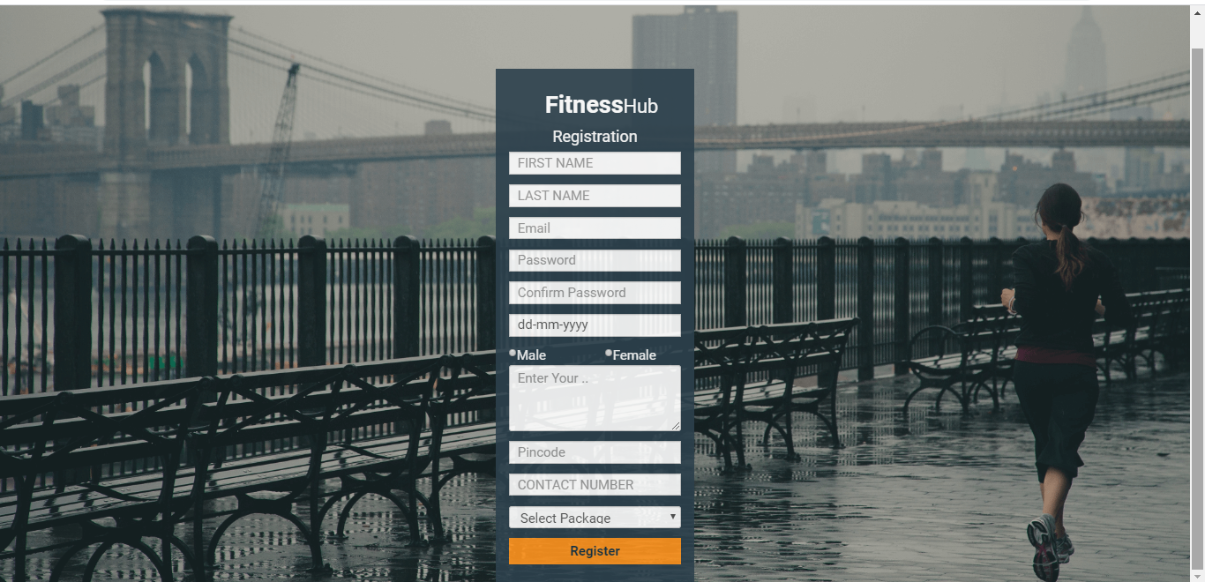
REGISTRATION :
In Registration Page All User Can Register Themselves To Join Fitness Hub.

Slide 2
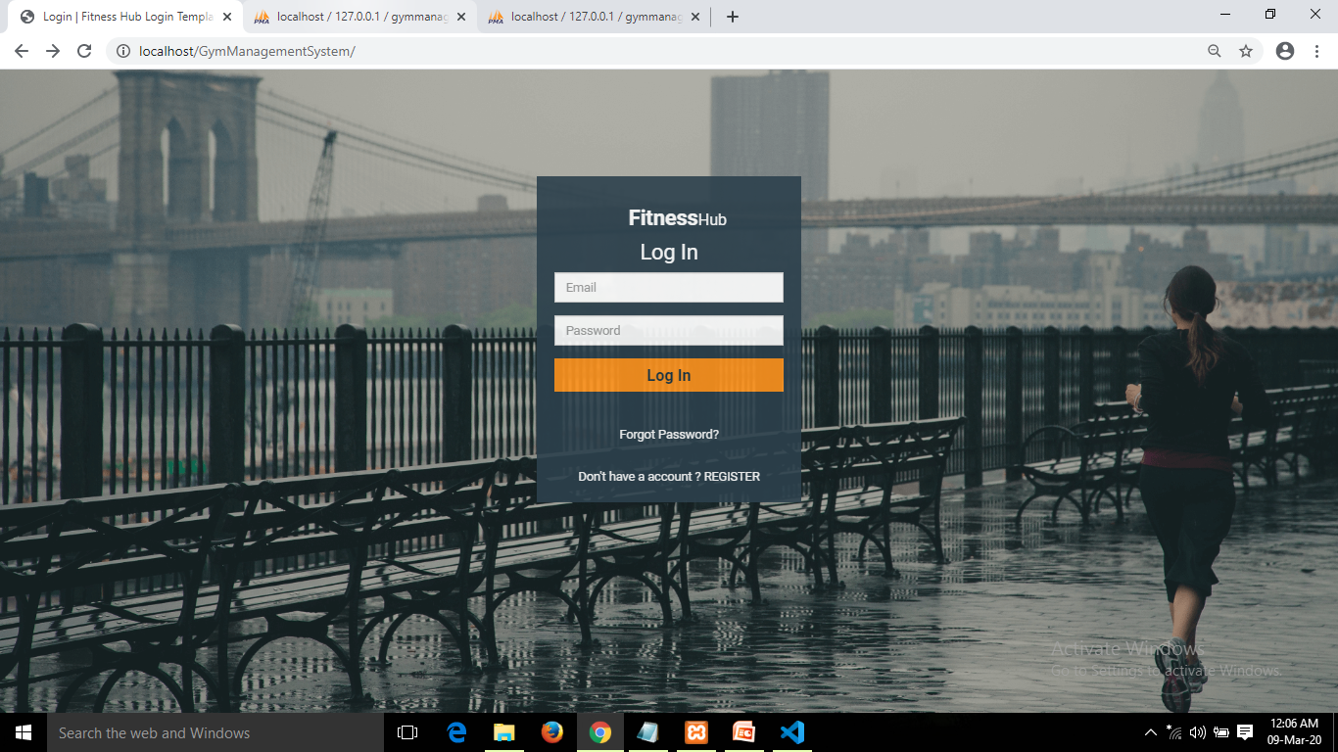
LOGIN :
After Registration User Can Log In The System By Entering Email Id And Valid Password.
If Forget His / Her Password Then By Clicking On Link It Will Be Renewed By Mail.

Slide 3
ADMIN

Slide 4
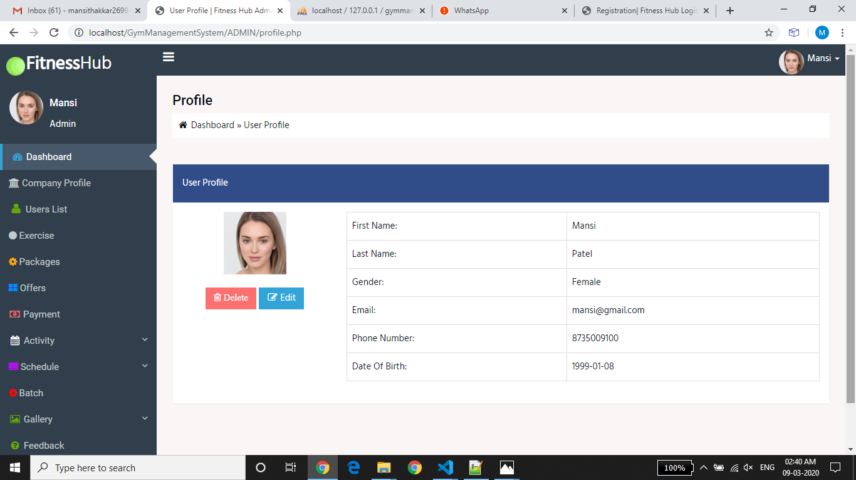
ADMIN PROFILE :

Slide 5
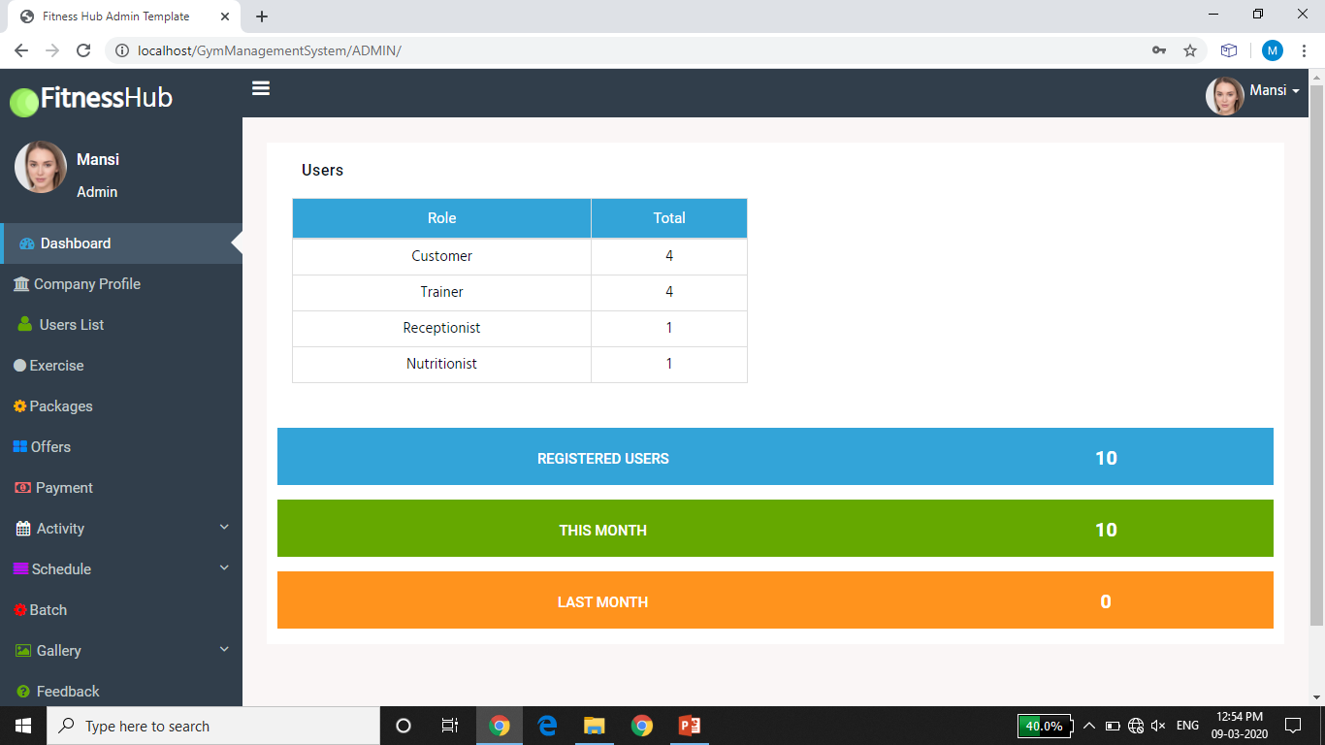
ADMIN DASHBOARD:

Slide 6
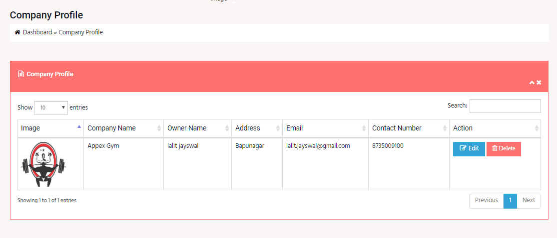
COMPANY PROFILE :
Here, Admin Can Manage Profile Of Company And Also Edit And Delete It.

Slide 7
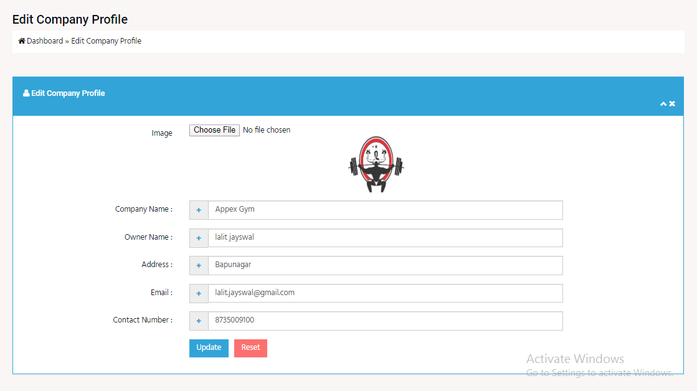
EDIT COMPANY PROFILE
Here, Admin Can Edit Profile Of Company.

Slide 8
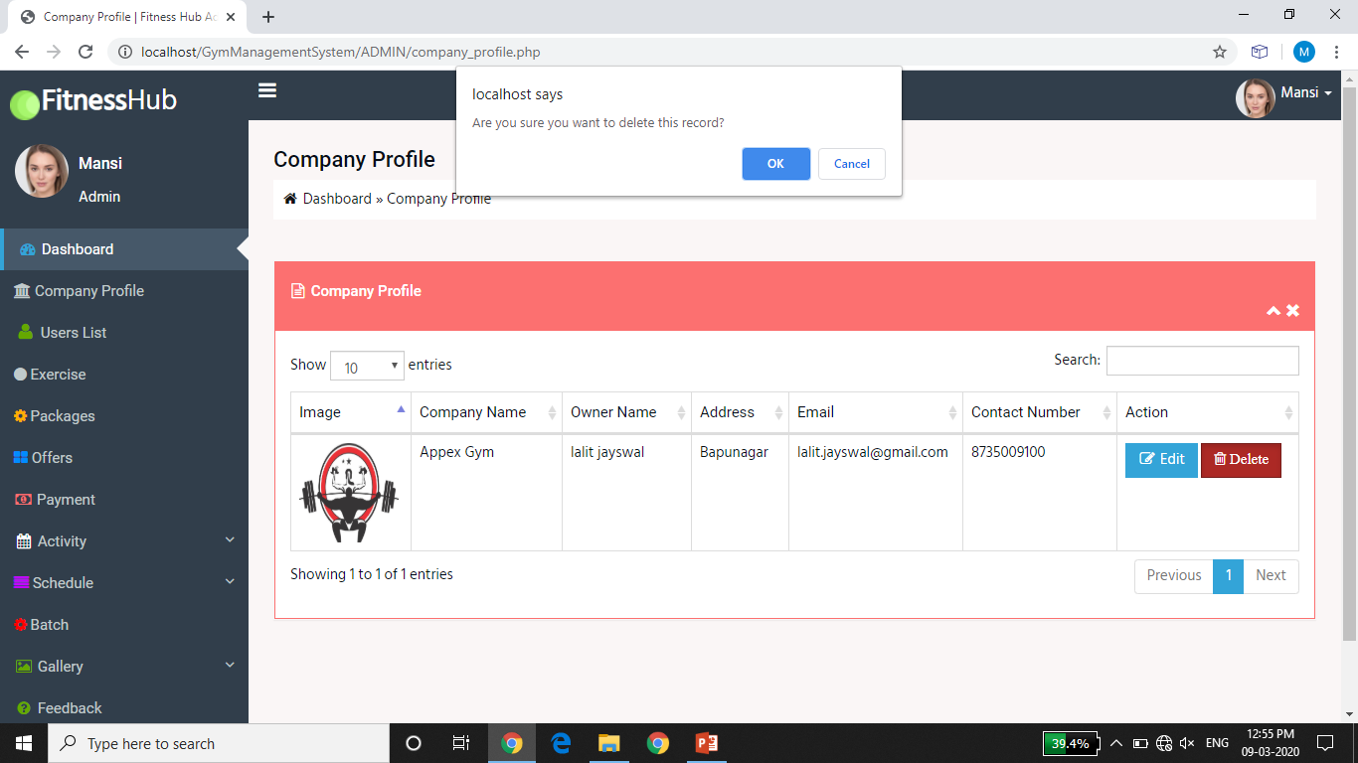
DELETE COMPANY PROFILE
Admin Can Delete Company Profile By Clicking On Delete And It Will Delete From The Database.

Slide 9
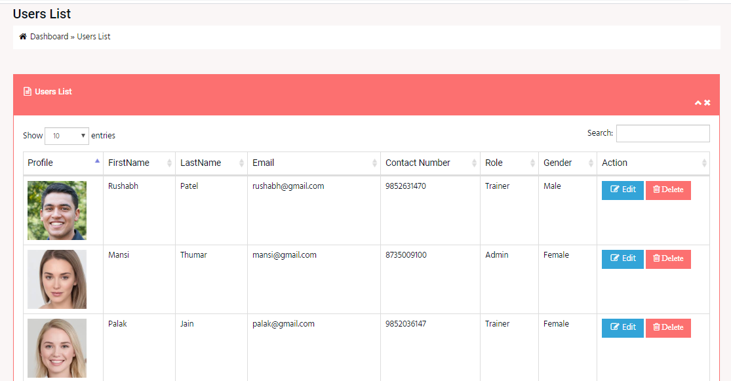
USER LIST :
Admin Can Manage The User List .

Slide 10
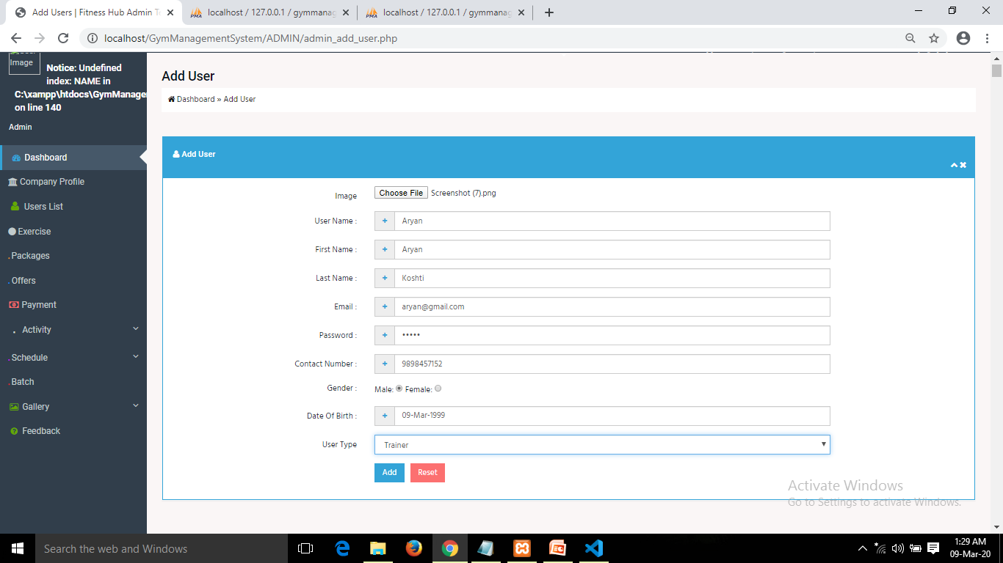
ADD USER :
Admin Can Add User And Allocate User Type ,That Is Trainer ,Receptionist , Nutritionist Or Customer.

Slide 11
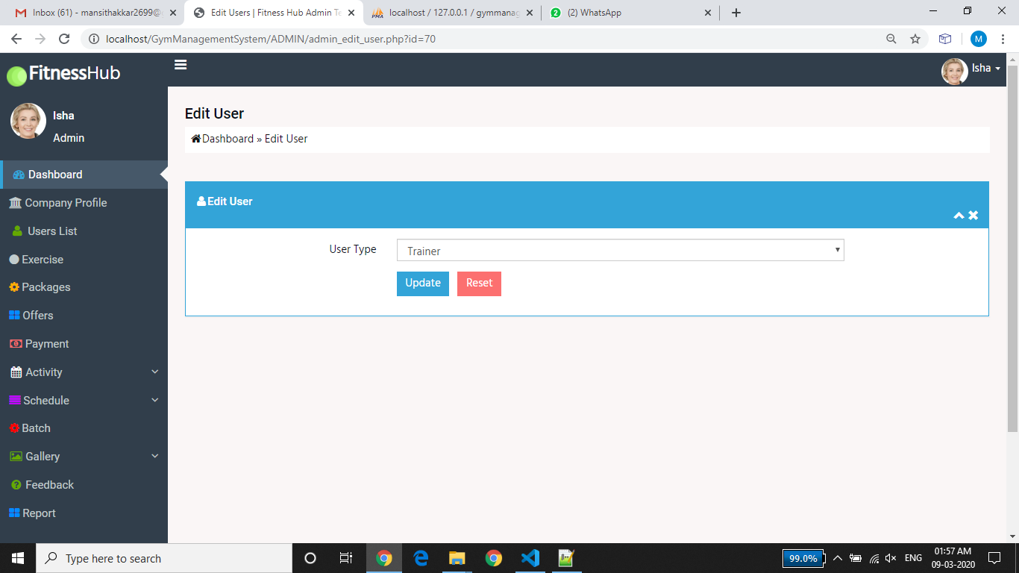
EDIT USER :
In Edit User Admin Can Edit Only Usertype Of All User Not Whole Details.

Slide 12
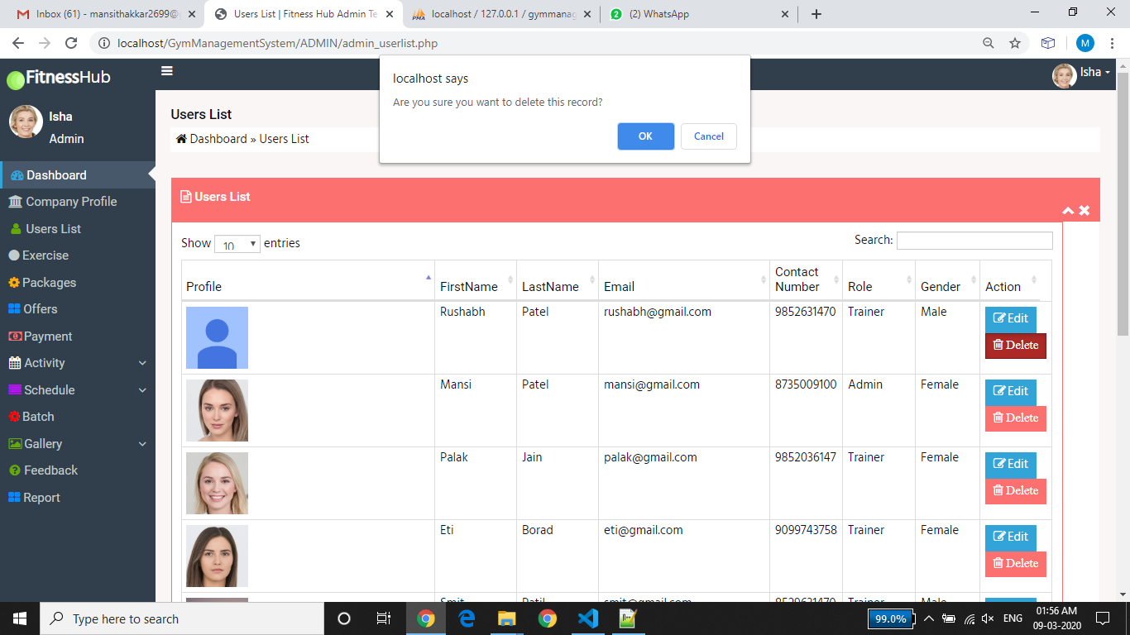
DELETE USER :
Here ,Admin Can Delete Perticular User Record.

Slide 13
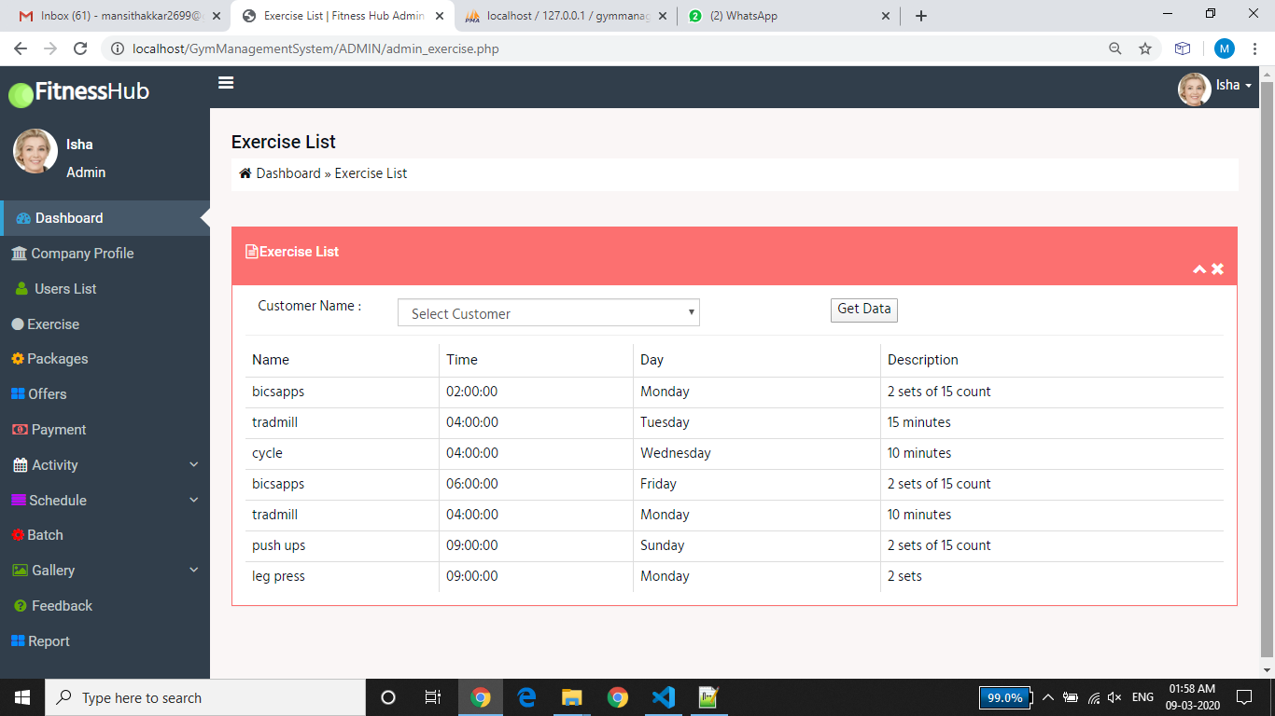
EXERCISE LIST:
Admin Can View Exercise List For Allocating Schedule.

Slide 14
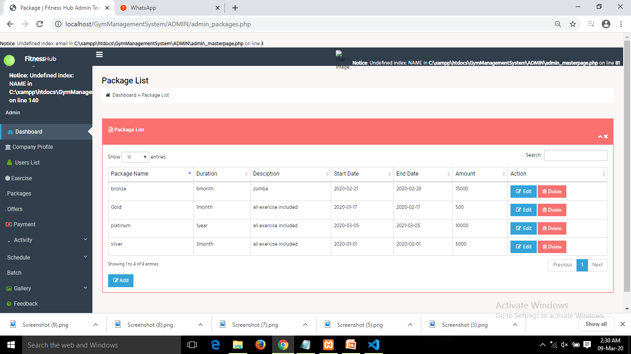
PACKAGES :
Admin Can Add Perticular Packages And Manage It.

Slide 15
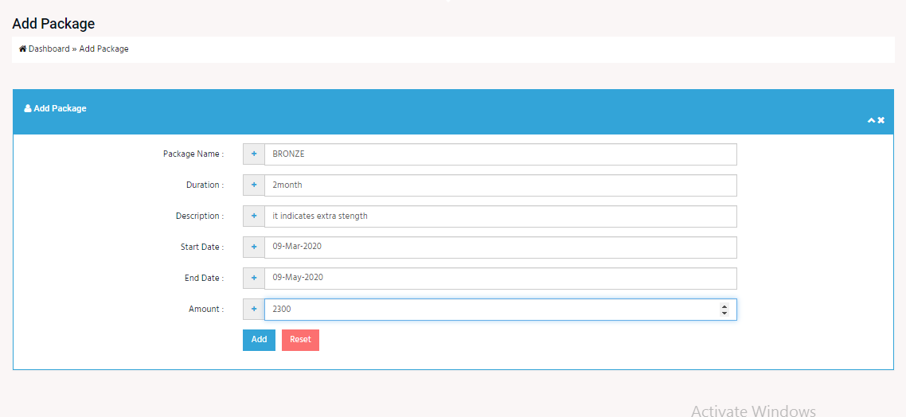
ADD PACKAGE :
Here, Admin Can Add Packages By Entering Start Date , End Date Of Package And Its Amount.

Slide 16
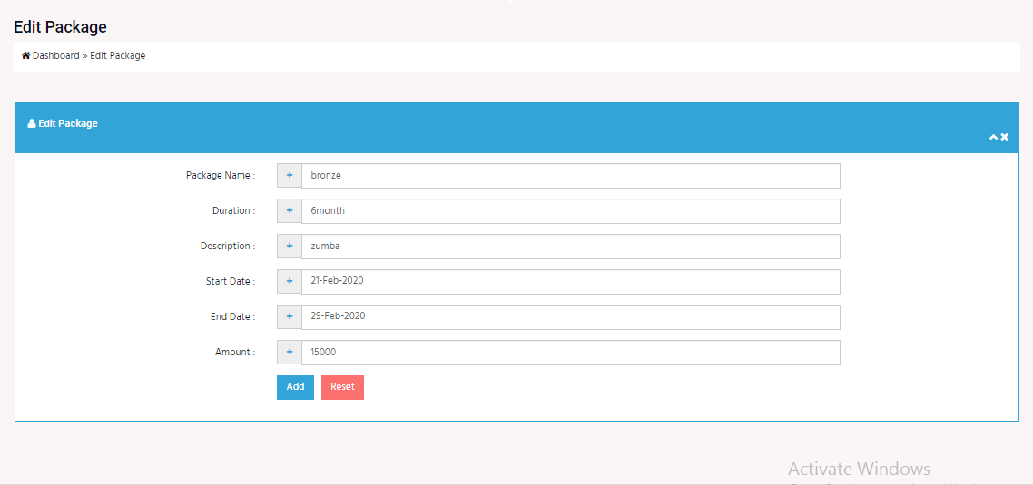
EDIT PACKAGE :
Admin Can Edit And Delete Packages Details From Database.

Slide 17
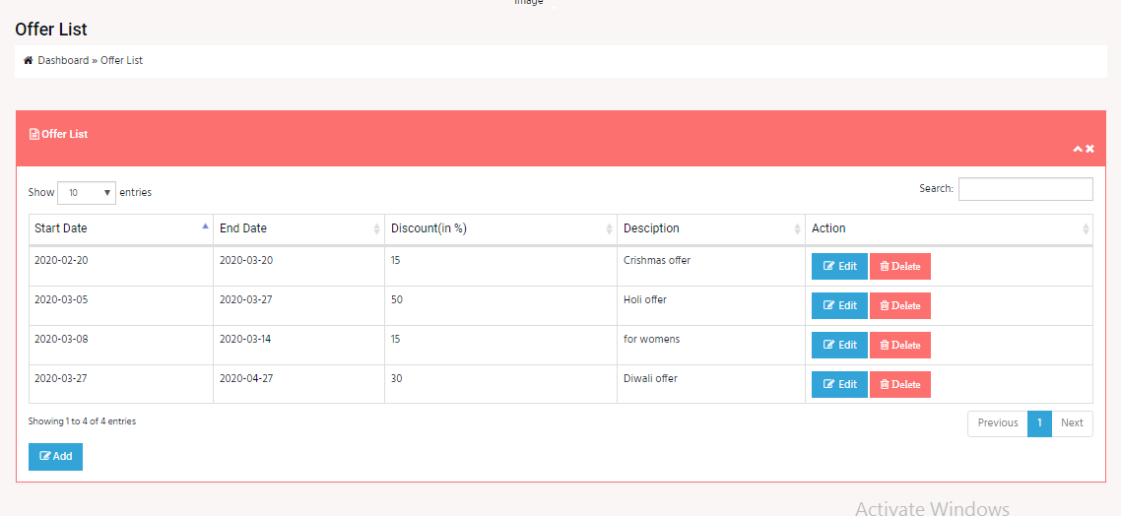
OFFER :
Admin Can Manage All Offers From Offer List.

Slide 18
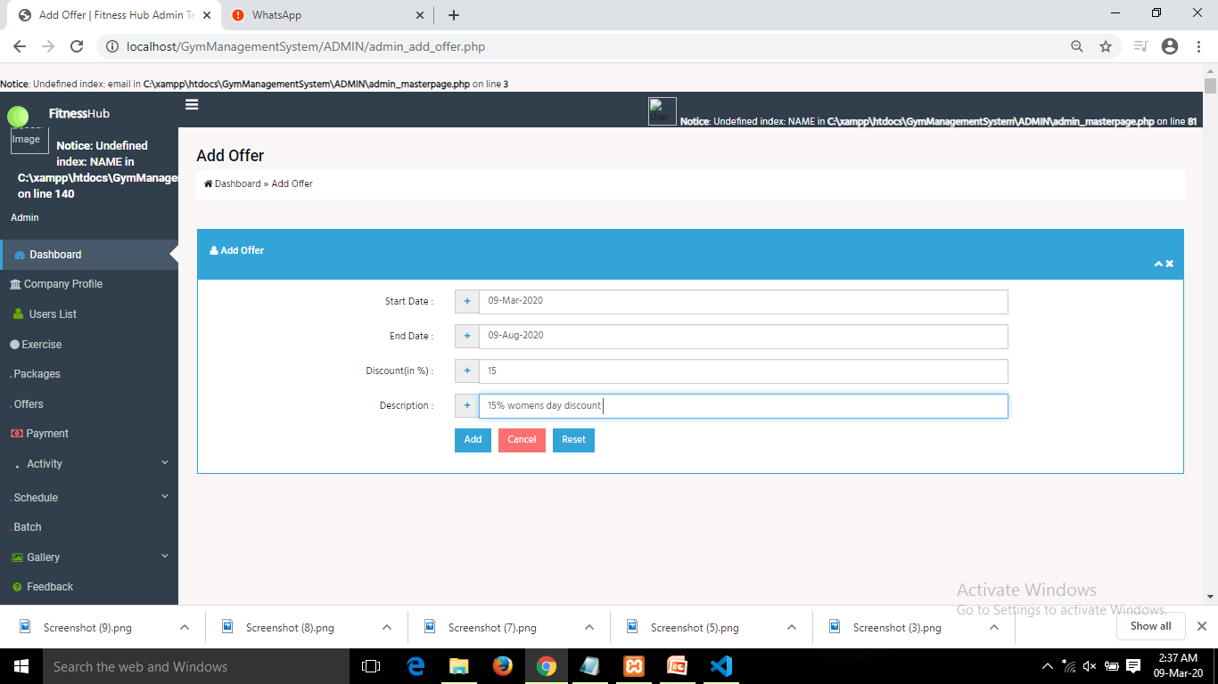
ADD OFFER :
Admin Can Add Offer With It One Liner Description And Discount Price.

Slide 19
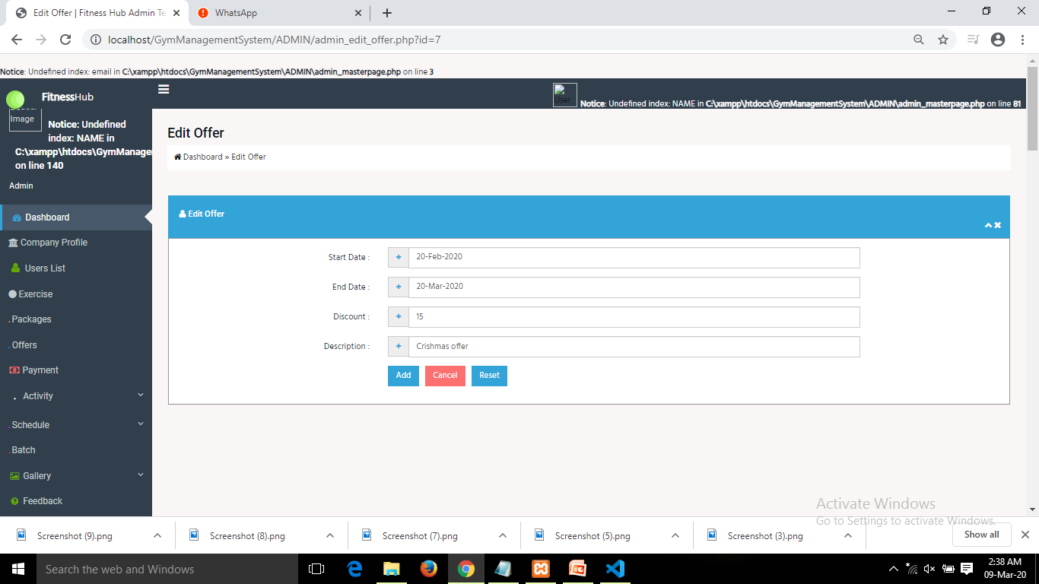
EDIT OFFER :

Slide 20
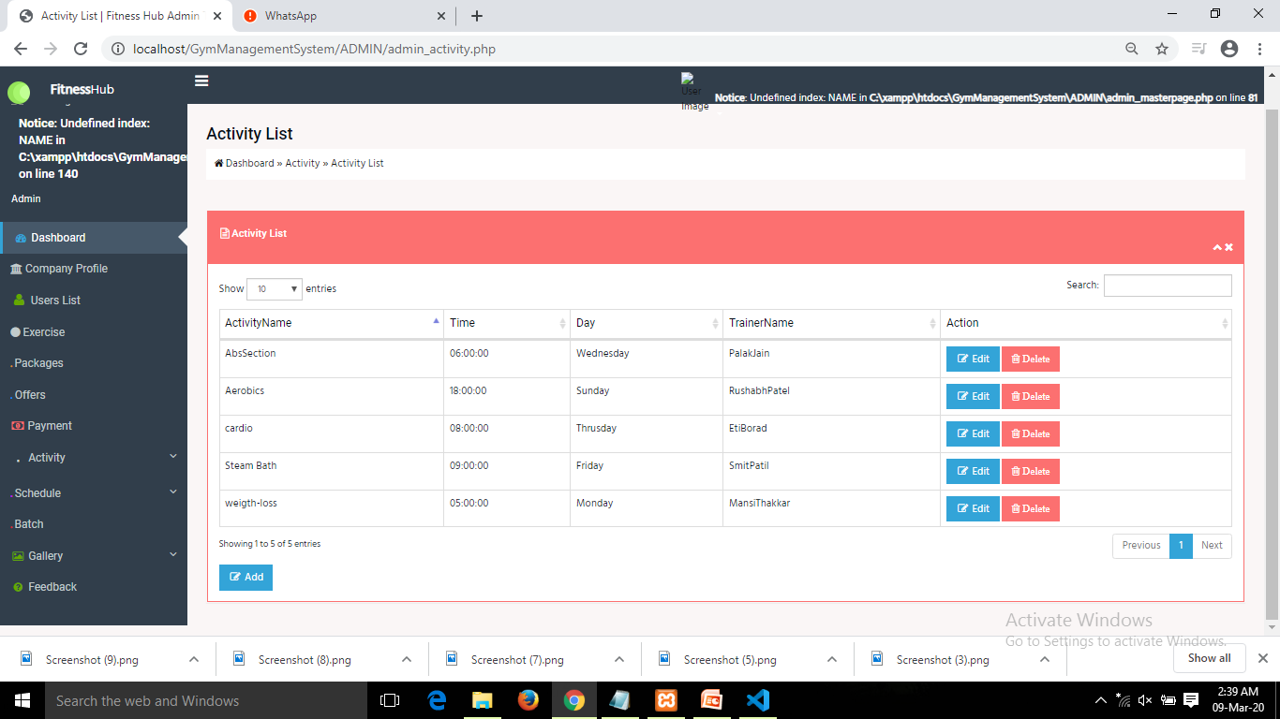
ACTIVITY LIST :
Admin Can Add , Edit And Delete Activity To Manage Activity List.

Slide 21
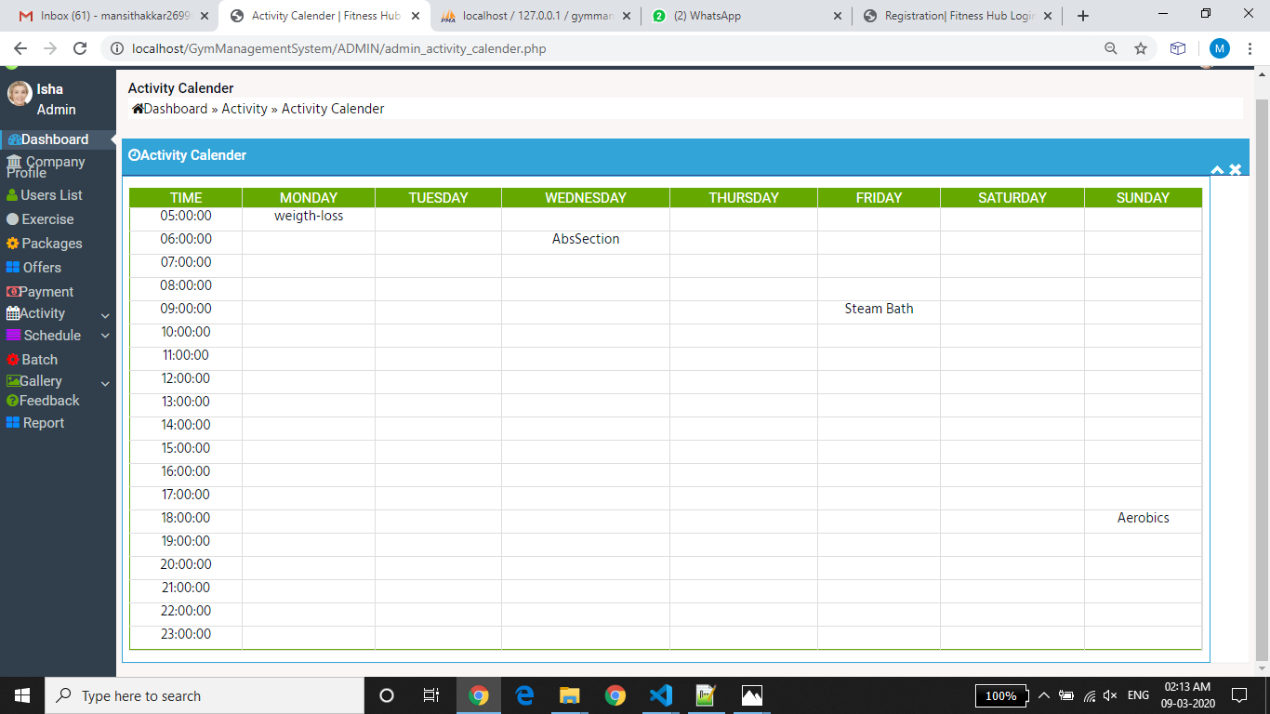
ACTIVITY CALENDER :

Slide 22
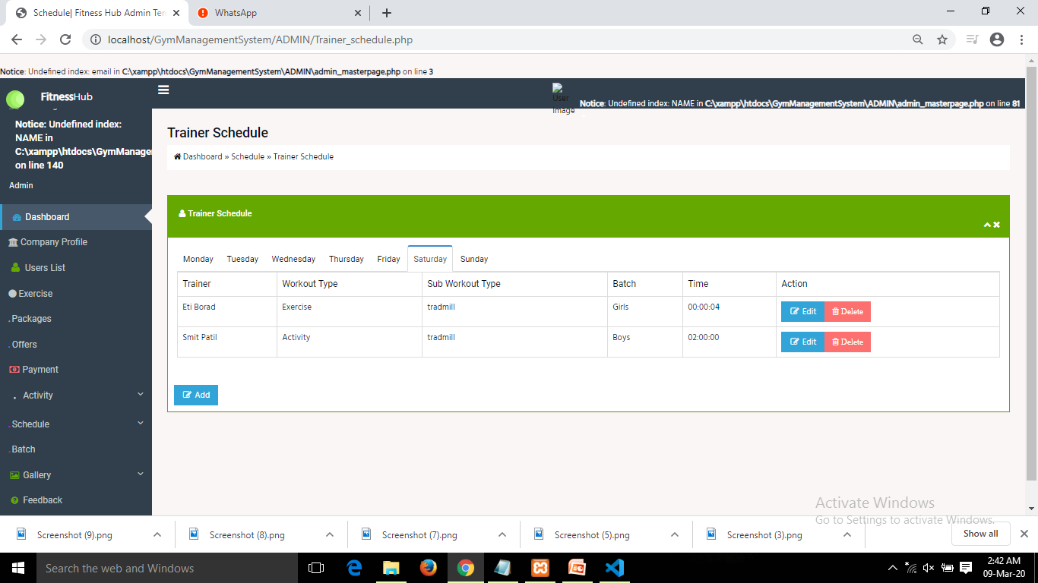
SCHEDULE :
TRAINER SCHEDULE :
By Trainer Schedule Admin Can Allocate Time Period To Trainers And Edit And Delete It.

Slide 23
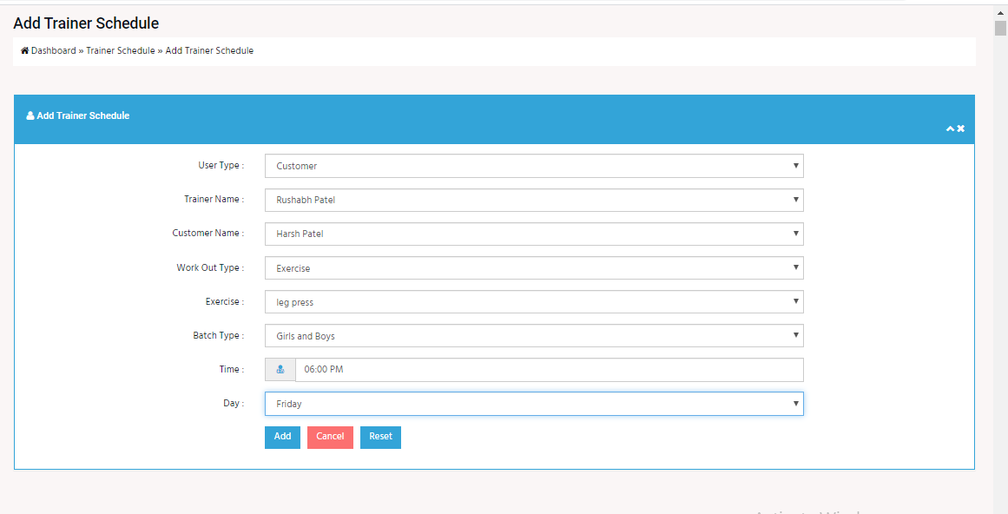
ADD TRAINER SCHEDULE :

Slide 24
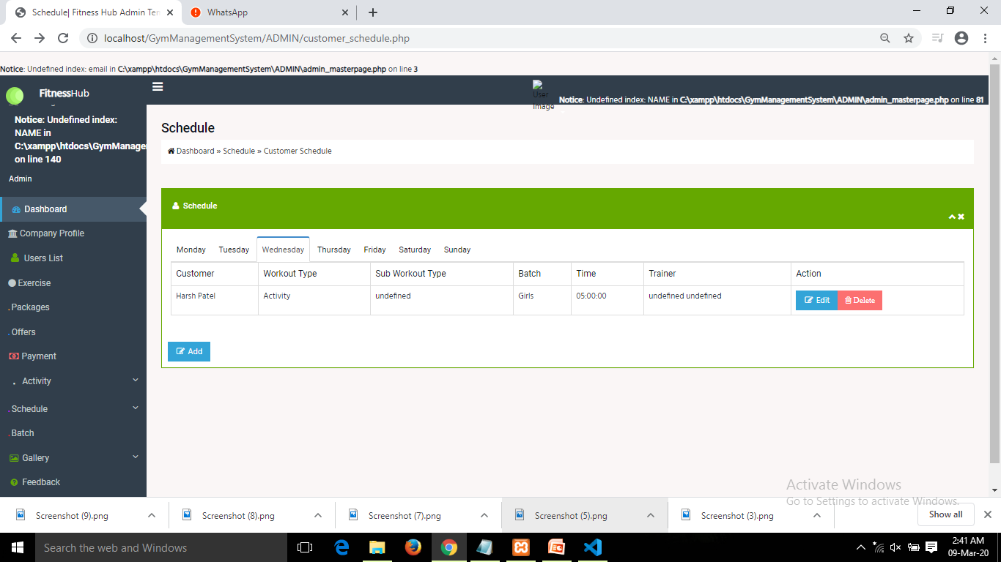
CUSTOMER SCHEDULE :
Admin Also Manages Customer Schedule.

Slide 25
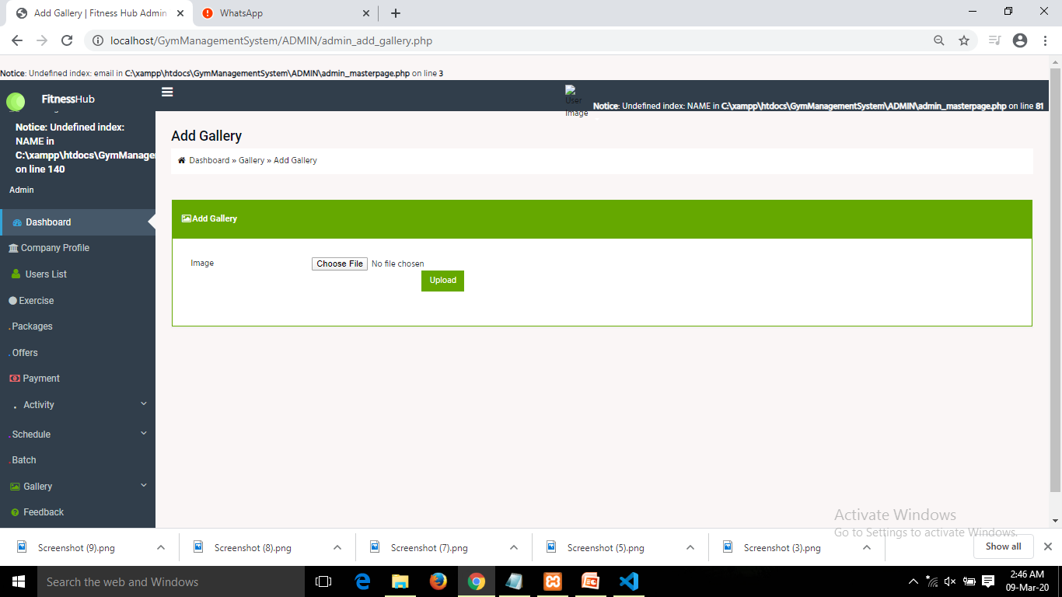
ADD GALLARY :
Here, Admin Can Upload Photos And Videos By Choosing File And It Will Be Uploaded In The Gallery.

Slide 26
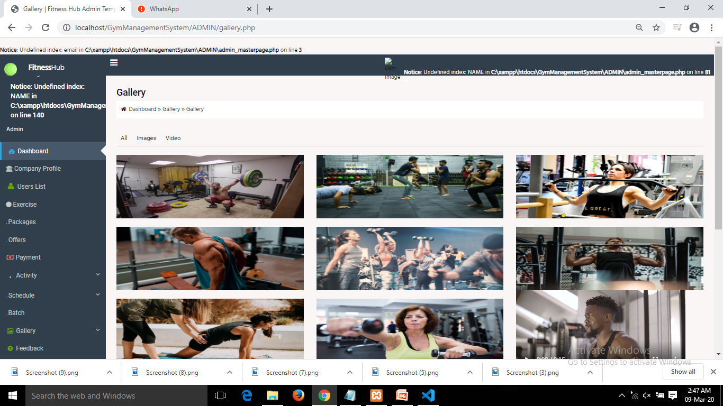
GALLARY :

Slide 27
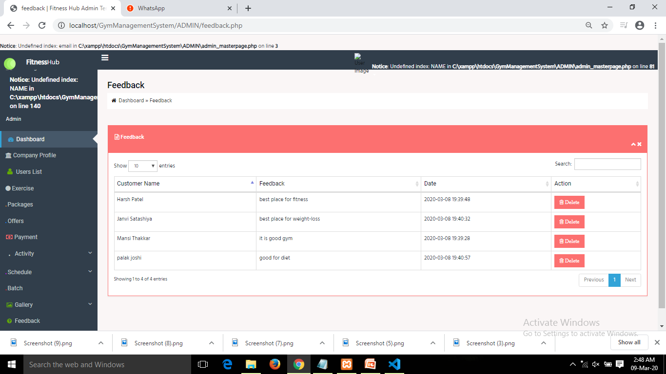
FEEDBACK :
Admin Can View Feedback Of Customer.

Slide 28
REPORTS :
Customer Report
Diet Report
Food details report
Exercise report
Activity Report
Nutritionist Report
Attendance Report
Customer wise attendance
Trainer wise attendance
Receptionist Report
Schedule Report
Customer wise schedule
Trainer wise schedule
Customer Measurement Report

Slide 29
TRAINER

Slide 30
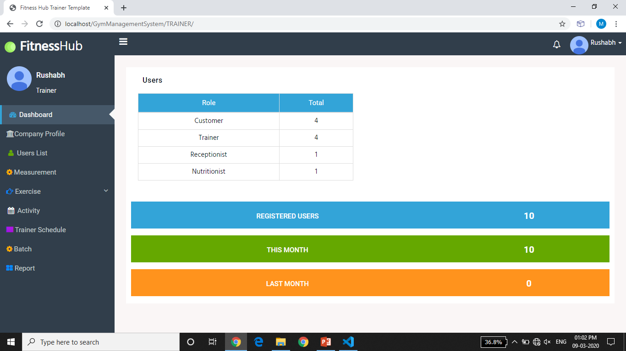
TRAINER DASHBOARD :

Slide 31
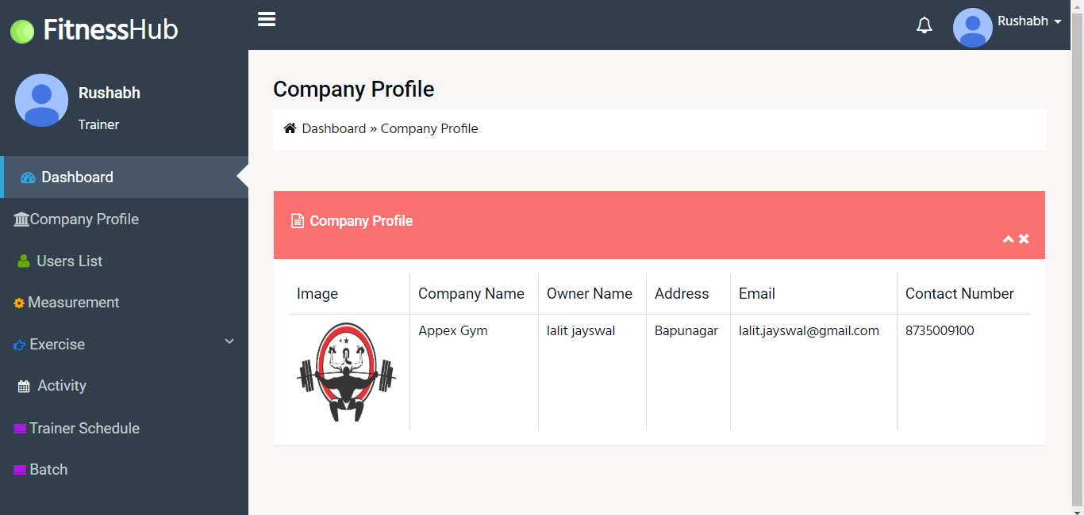
COMPANY PROFILE :

Slide 32
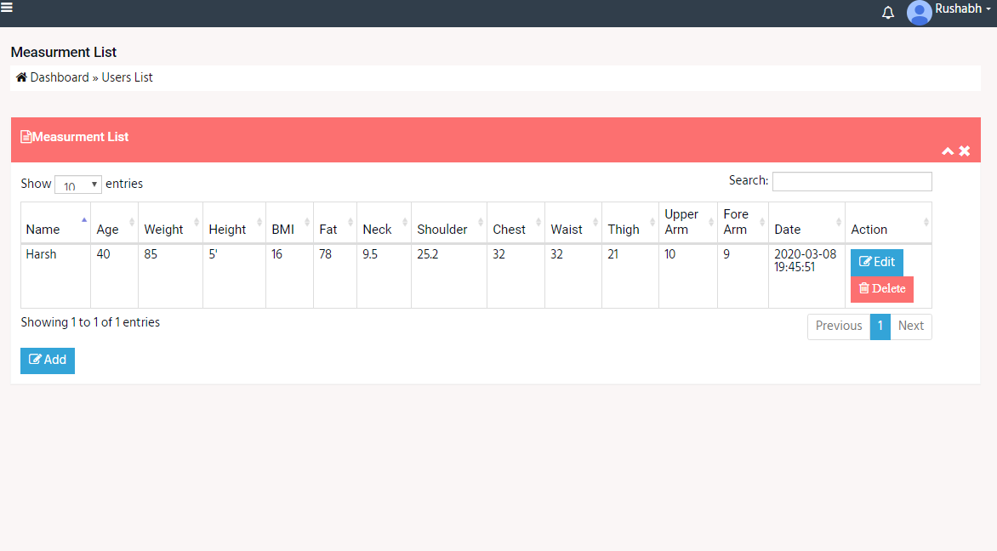
MEASURMENT LIST :

Slide 33
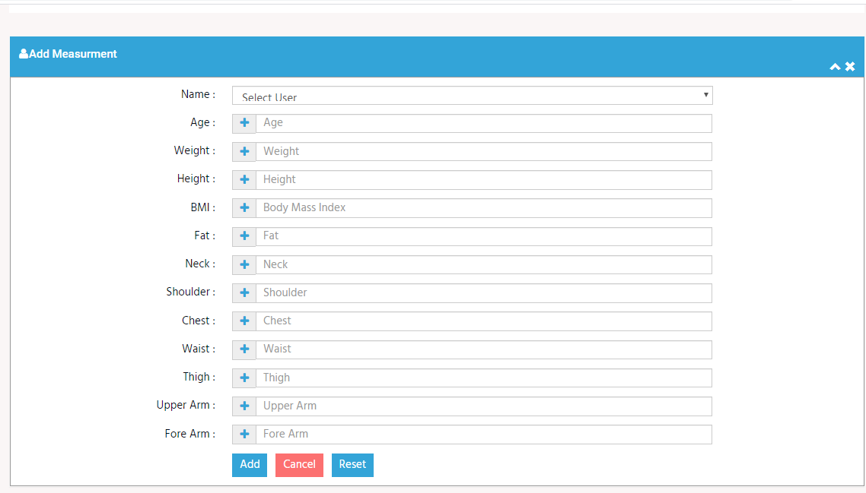
ADD MEASURMENT :

Slide 34

EDIT MEASURMENT :

Slide 35
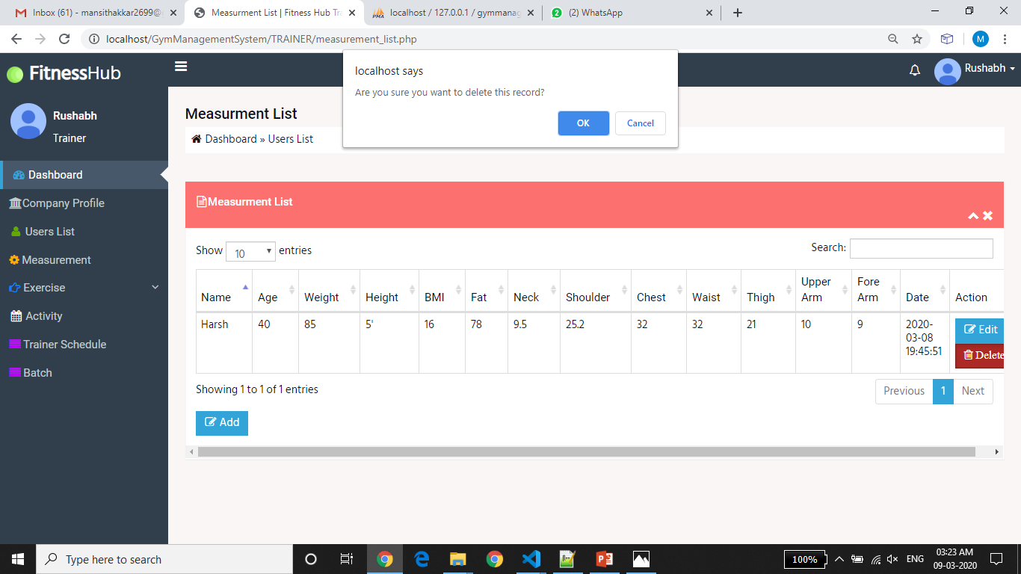
DELETE MEASURMENT LIST :

Slide 36
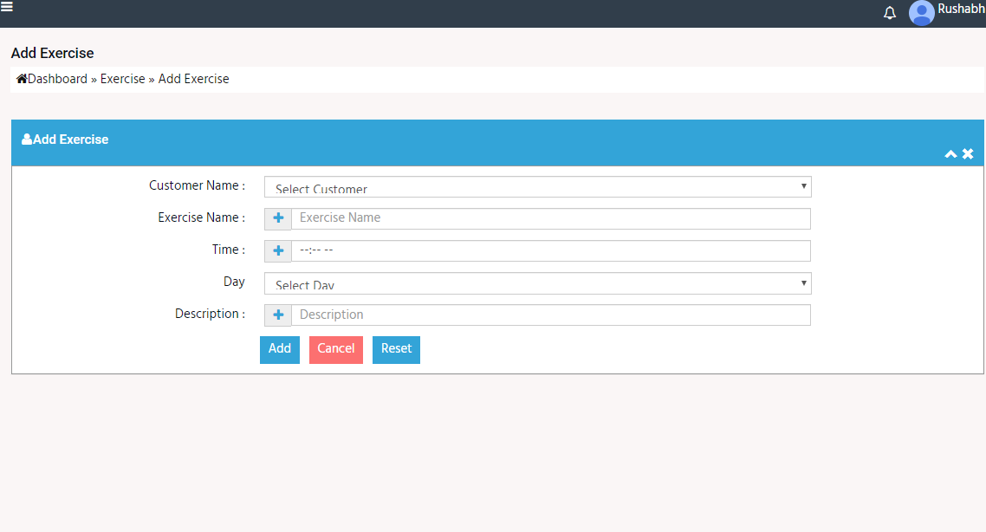
ADD EXERCISE :

Slide 37
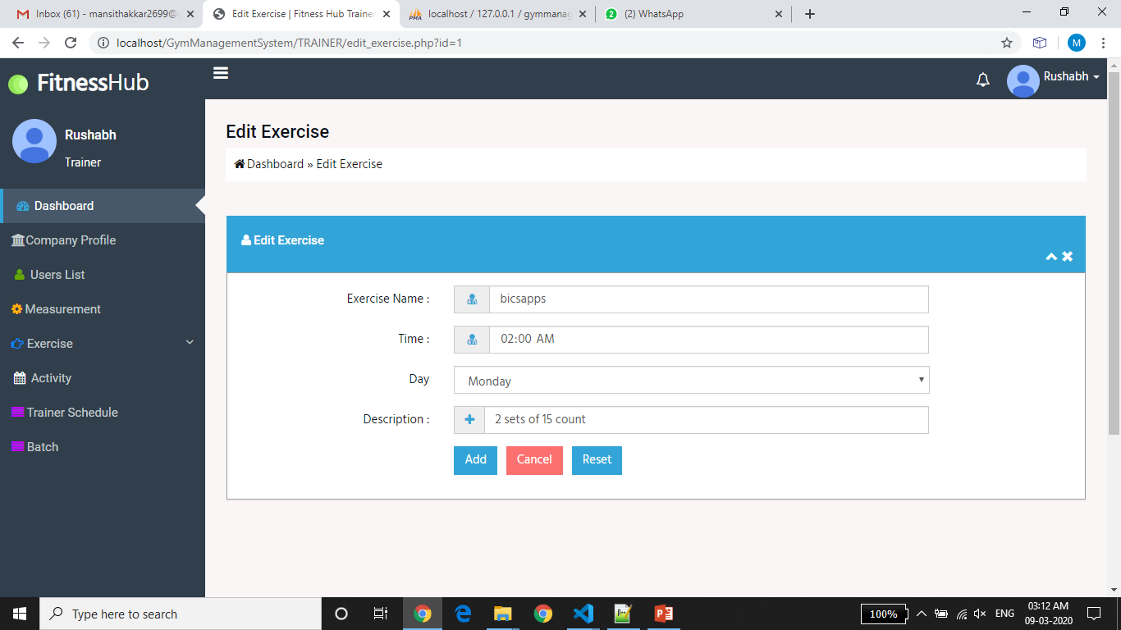
EDIT EXERCISE :

Slide 38
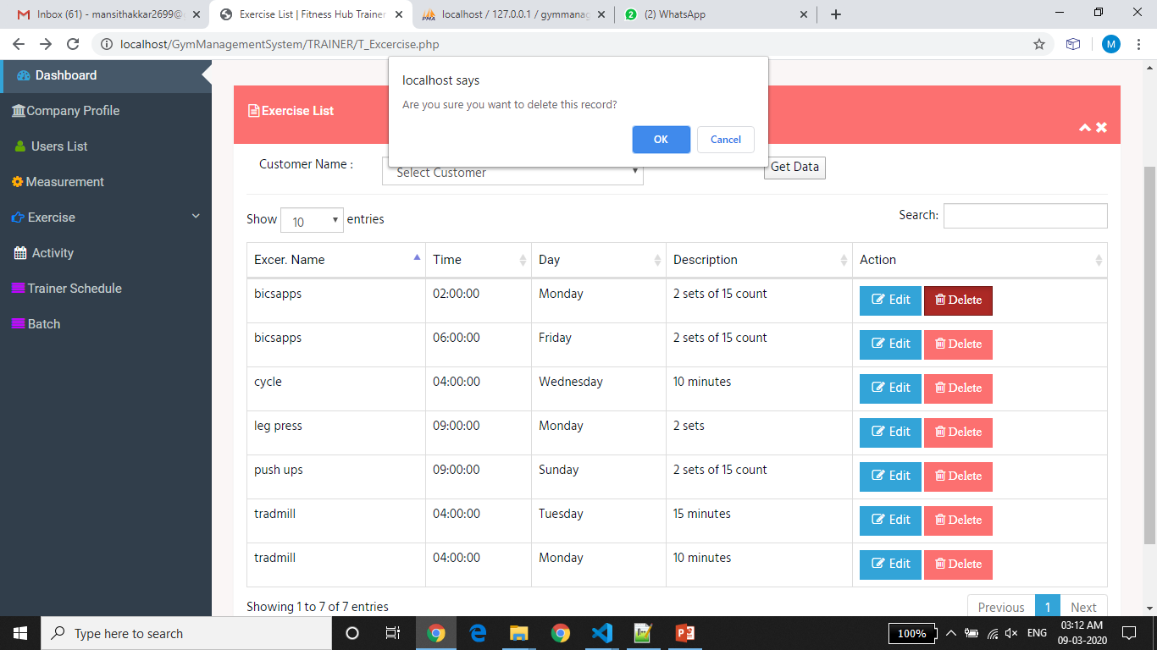
DELETE EXERCISE :

Slide 39
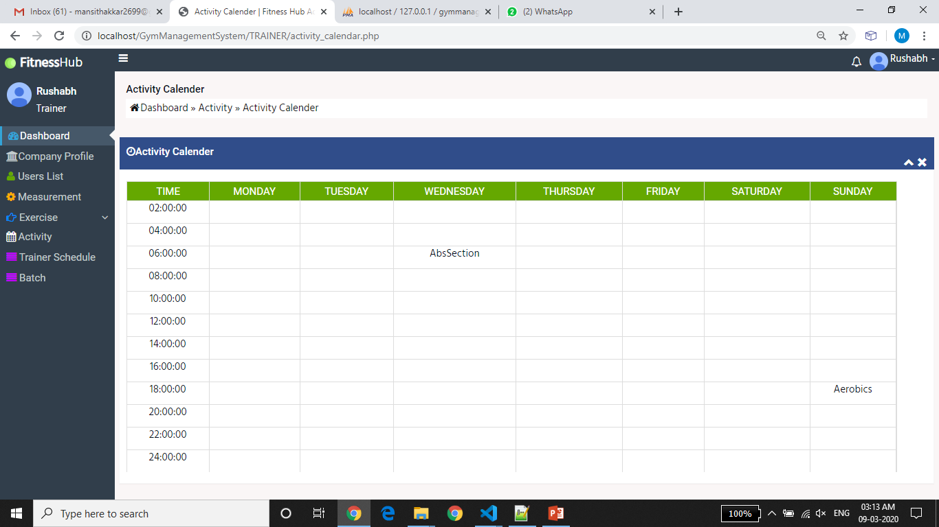
ACTIVITY CALENDER :

Slide 40
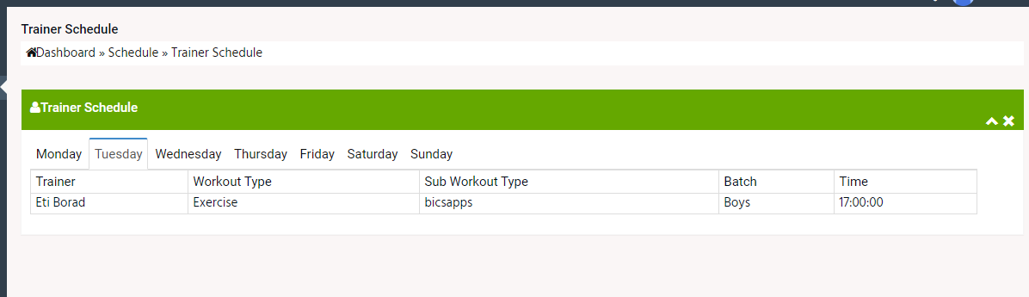
TRAINER SCHEDULE :

Slide 41
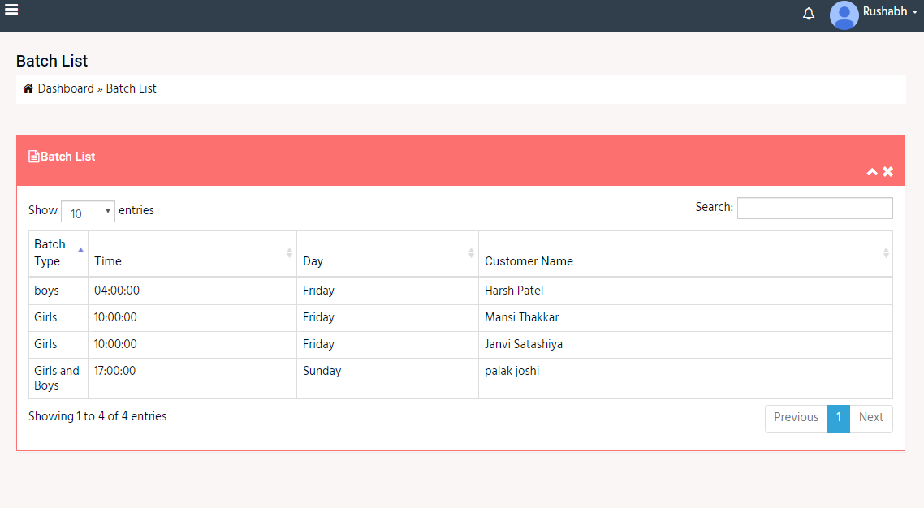
BATCH LIST :

Slide 42
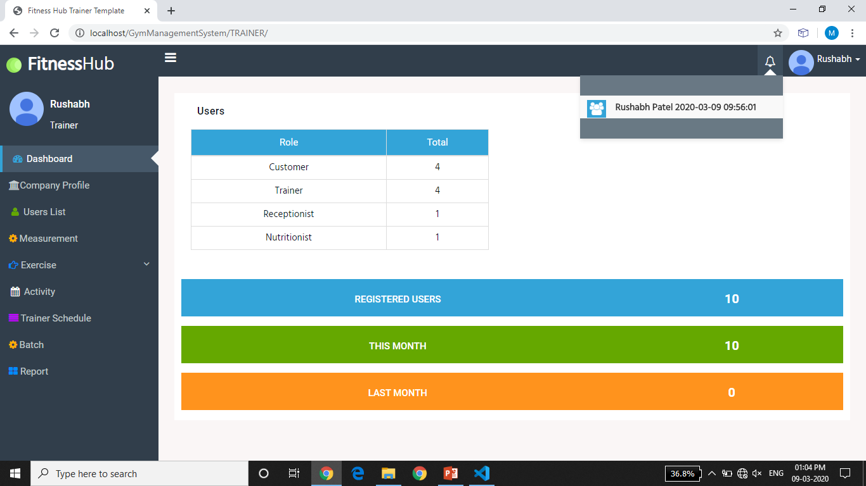
ATTENDENCE NOTIFICATION :

Slide 43
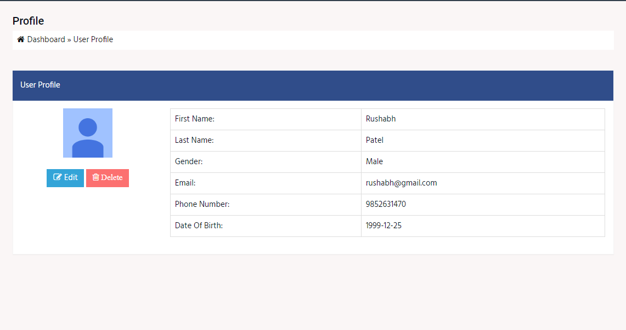
USER PROFILE :

Slide 44
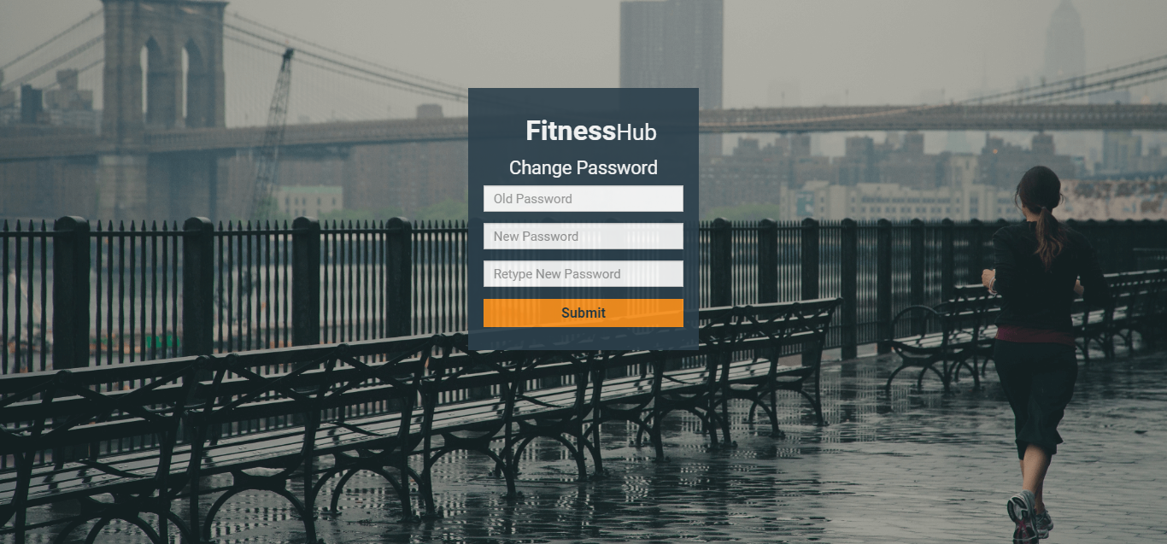
CHANGE PASSWORD :

Slide 45
REPORTS :
Activity Report
Customer wise attendance
Trainer wise attendance
Customer Report
Customer wise schedule
Trainer wise schedule
Exercise report
Customer Measurement Report
Nutritionist Report
Trainer report
Receptionist Report

Slide 46
RECEPTIONIST

Slide 47
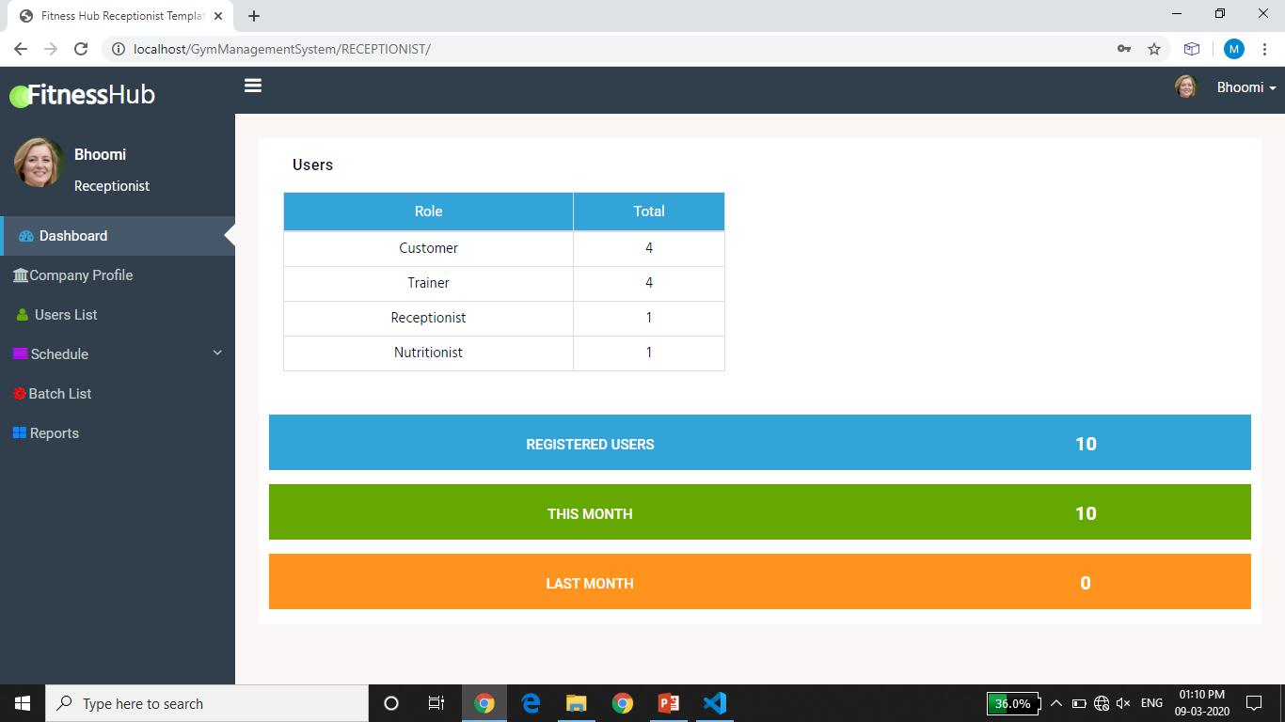
RECEPTIONIST DASHBOARD :

Slide 48
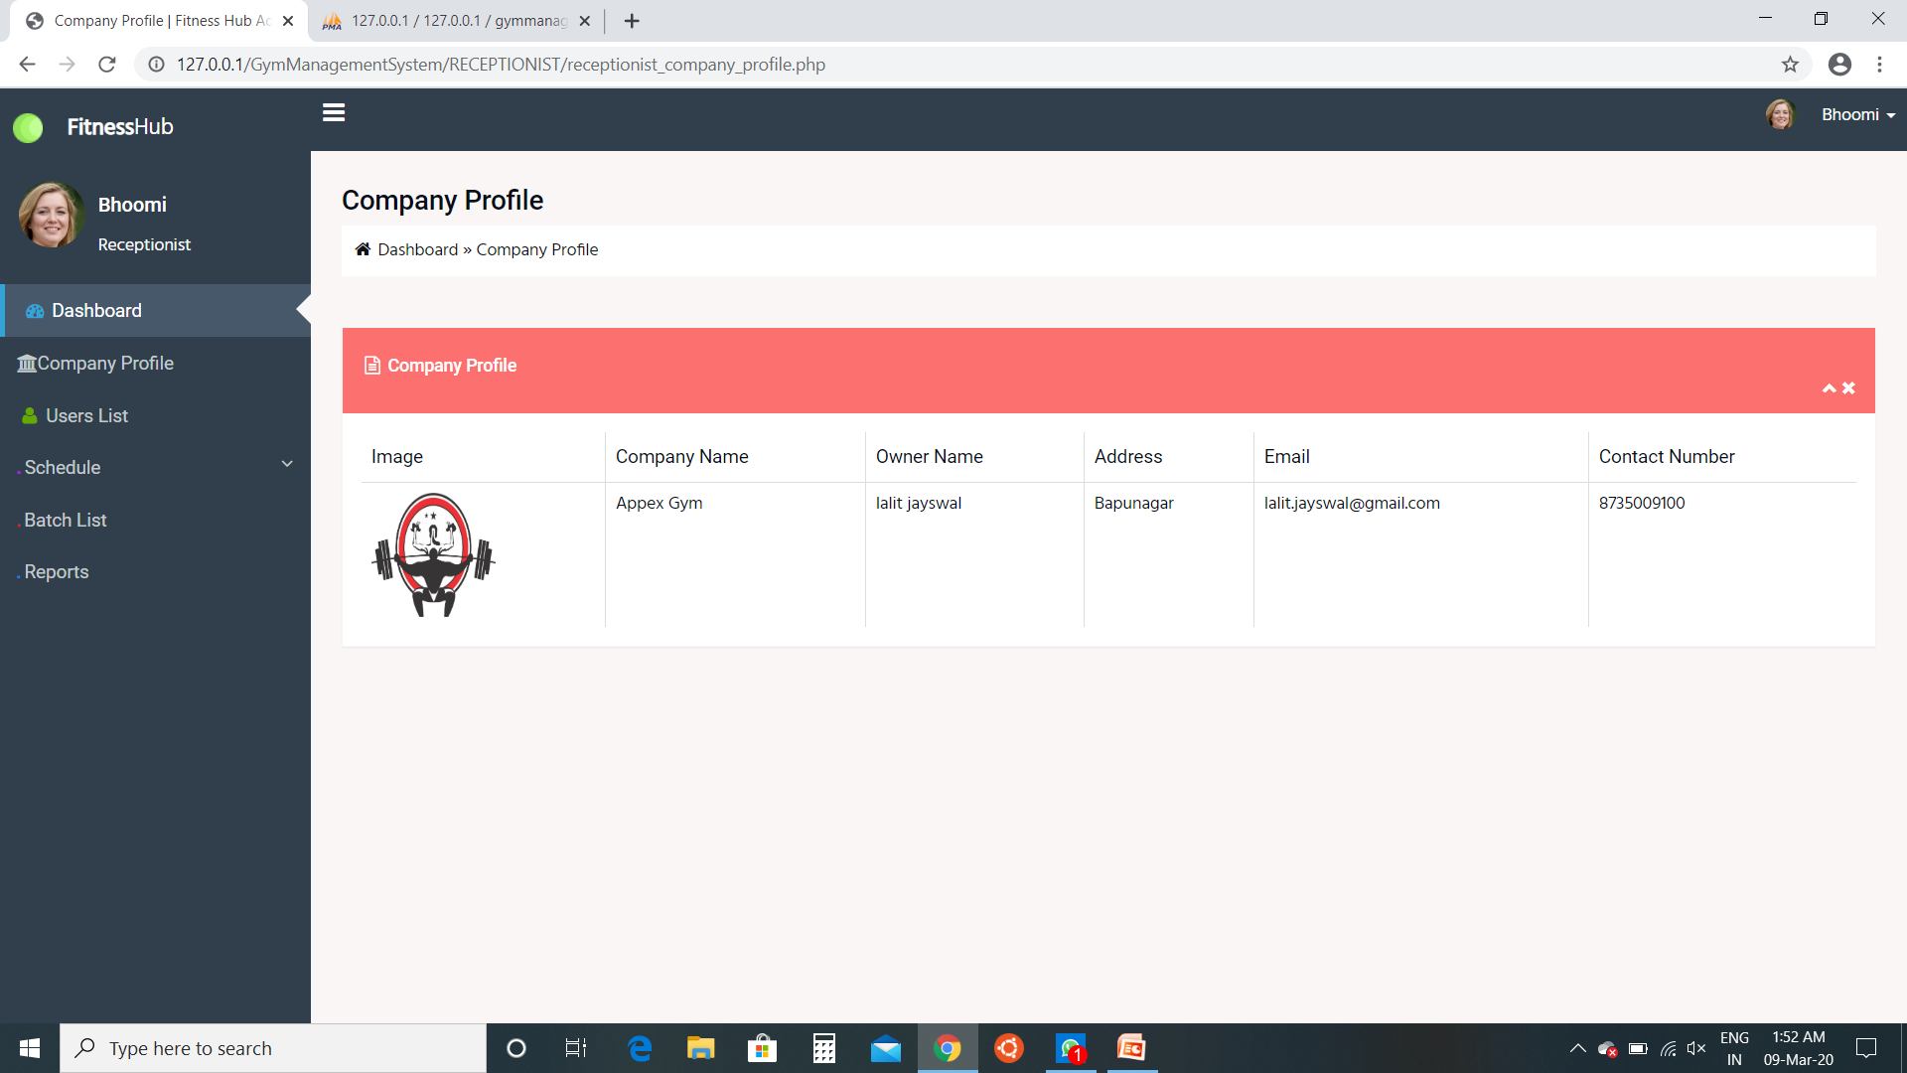
Company Profile:
Receptionist can view company profile

Slide 49
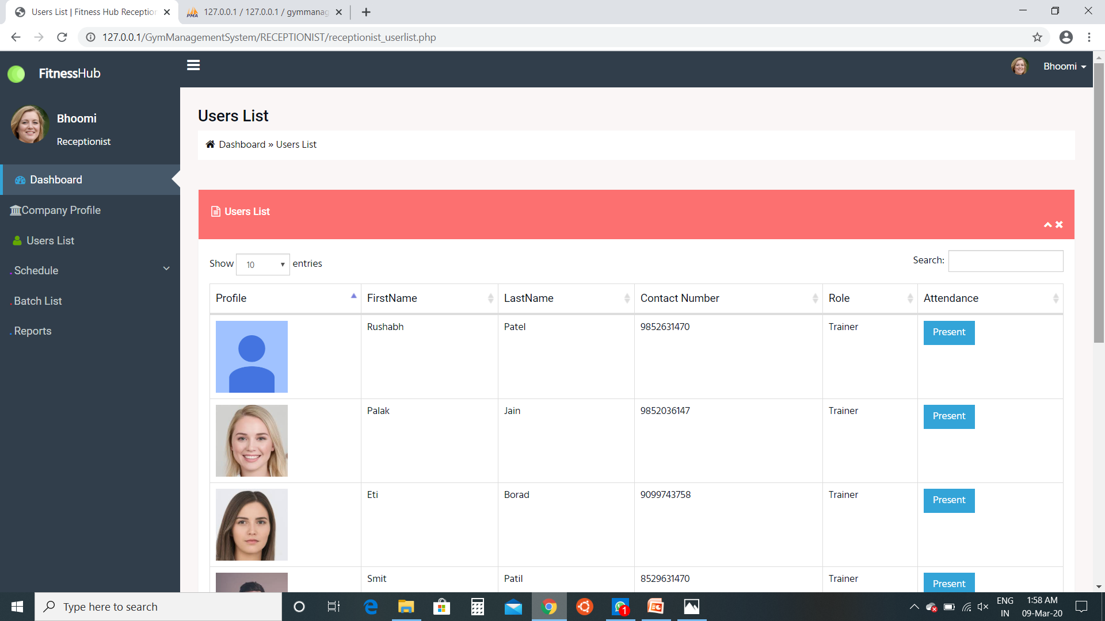
User List:
Receptionist can view user list and send attendance notification by clicking on present button to customer or trainer

Slide 50
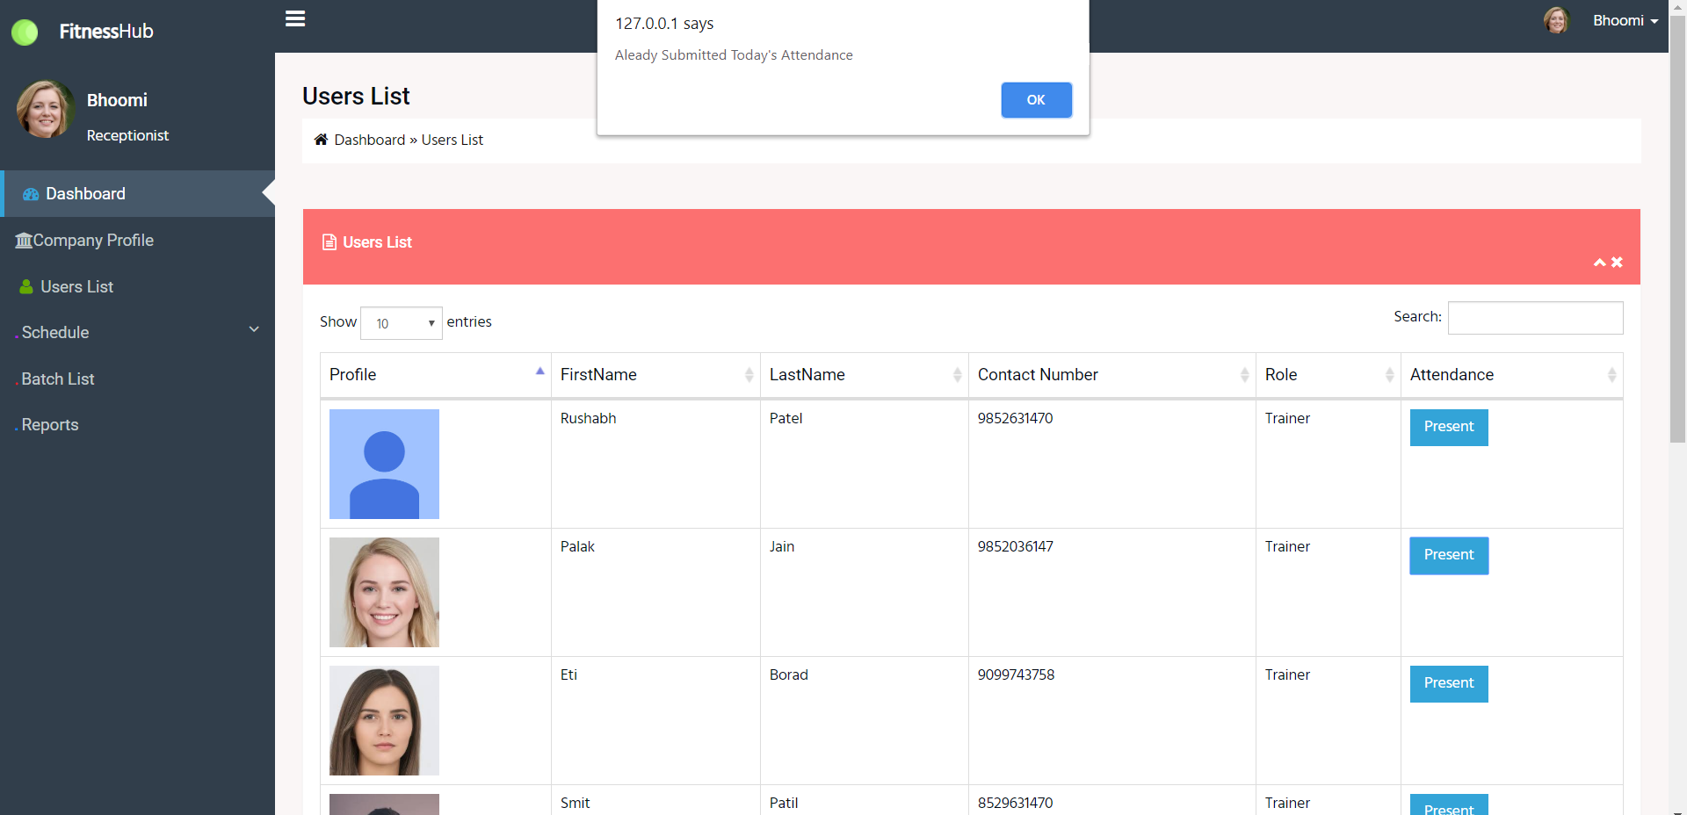
User List:
Receptionist can view user list and send attendance by clicking on present button to customer or trainer

Slide 51
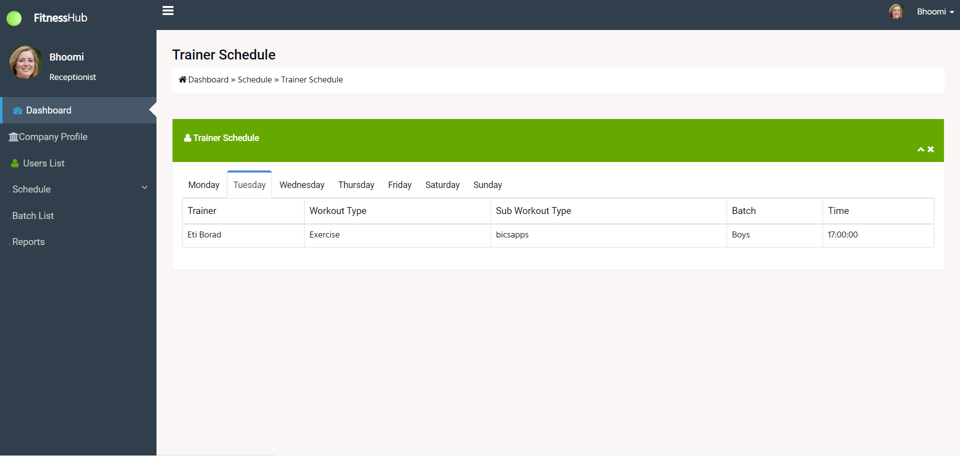
Trainer Schedule:
Receptionist can view trainer schedule by clicking on particular day.

Slide 52
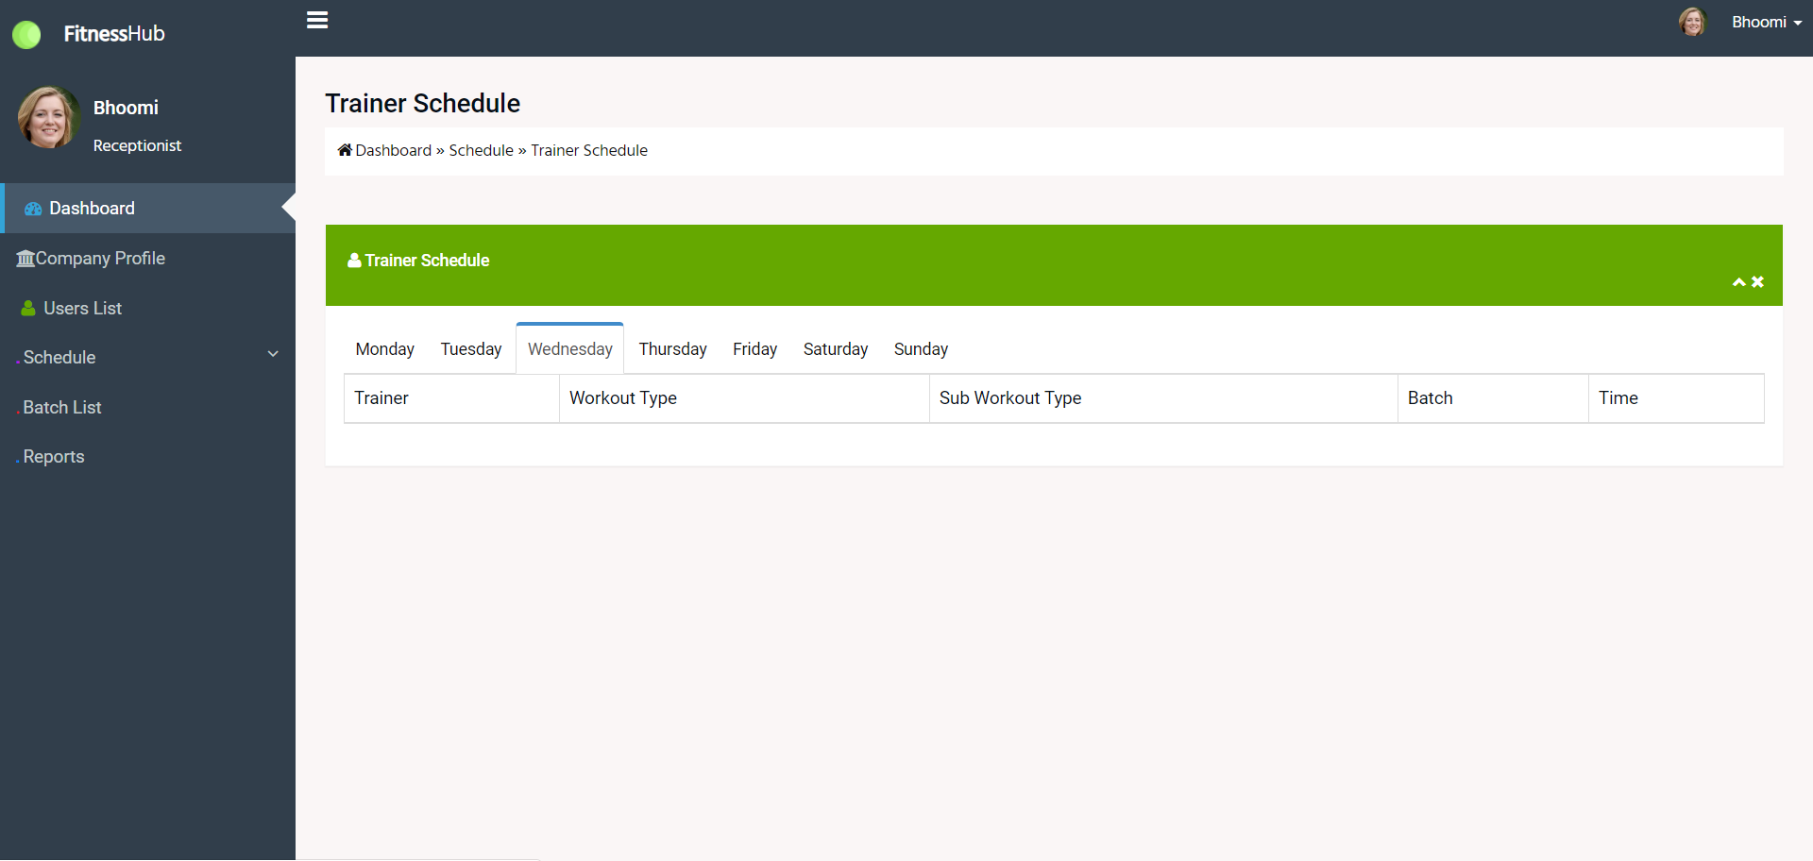
Trainer Schedule:
Receptionist can view trainer schedule by clicking on particular day.

Slide 53
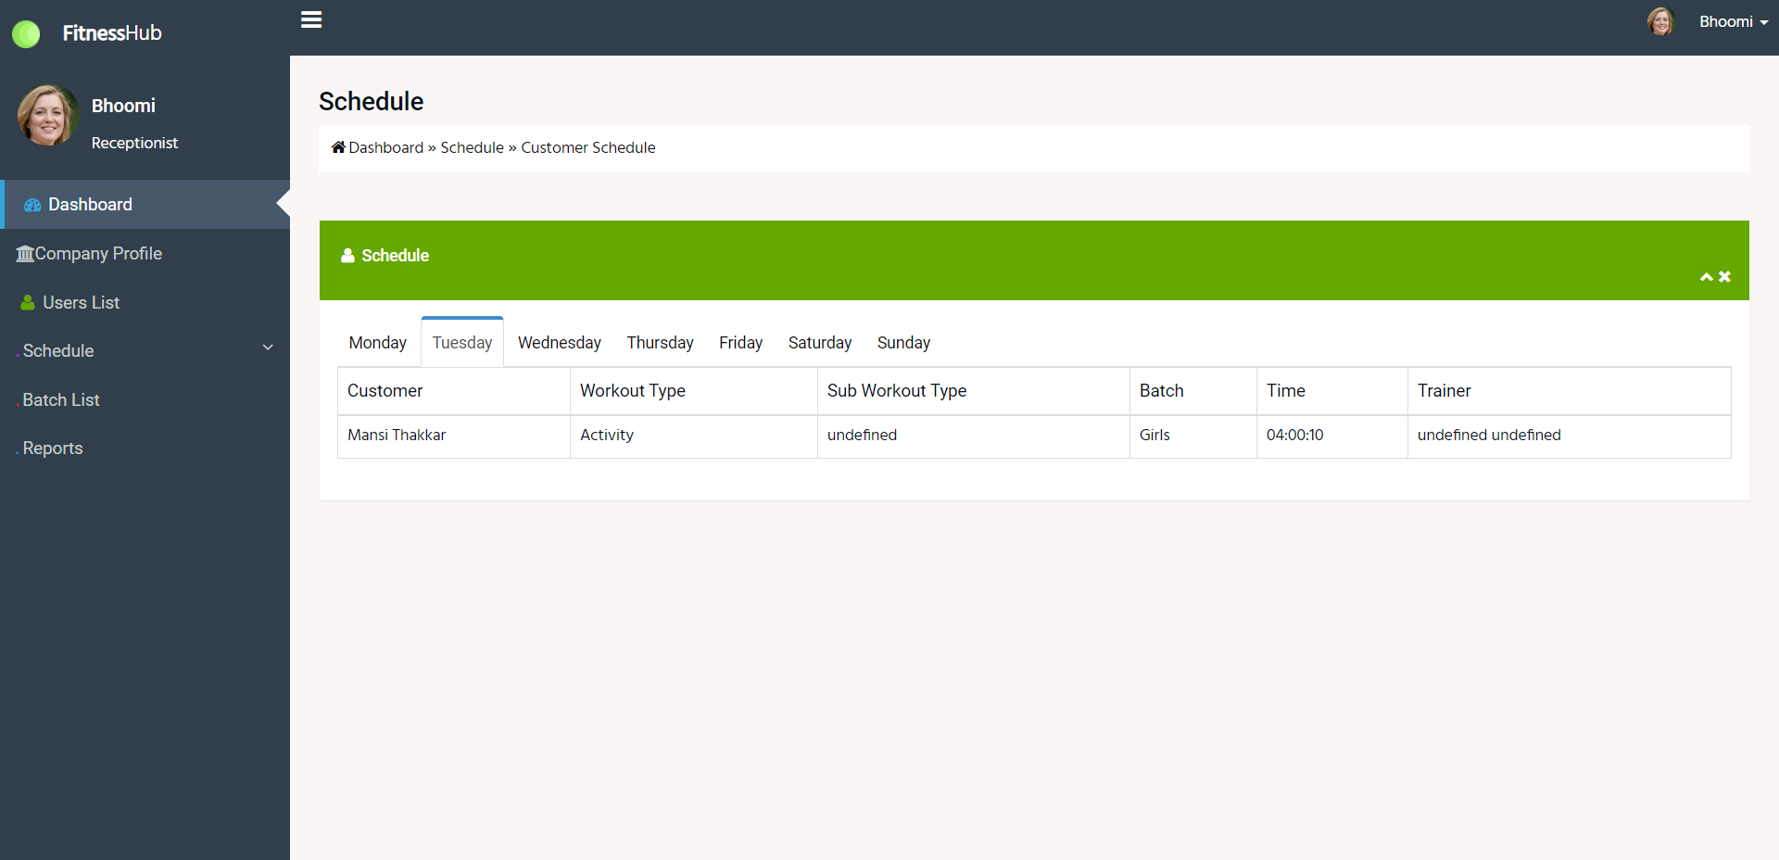
Customer Schedule:
Receptionist can view customer schedule by clicking on particular day.

Slide 54
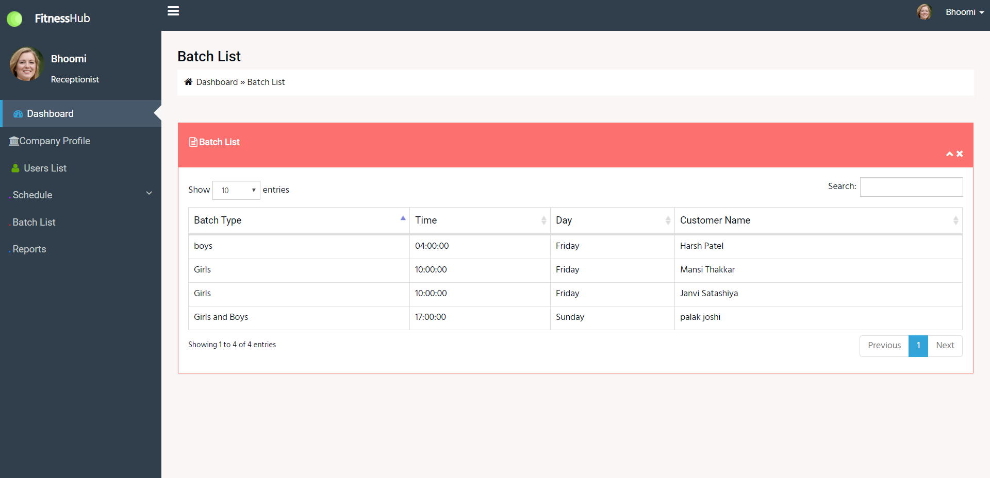
Batch List:
Receptionist can view batch list.

Slide 55
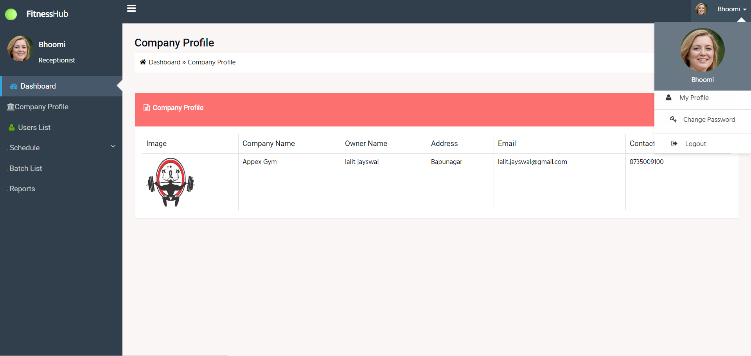
Manage profile:
Receptionist can manage his/her profile .

Slide 56
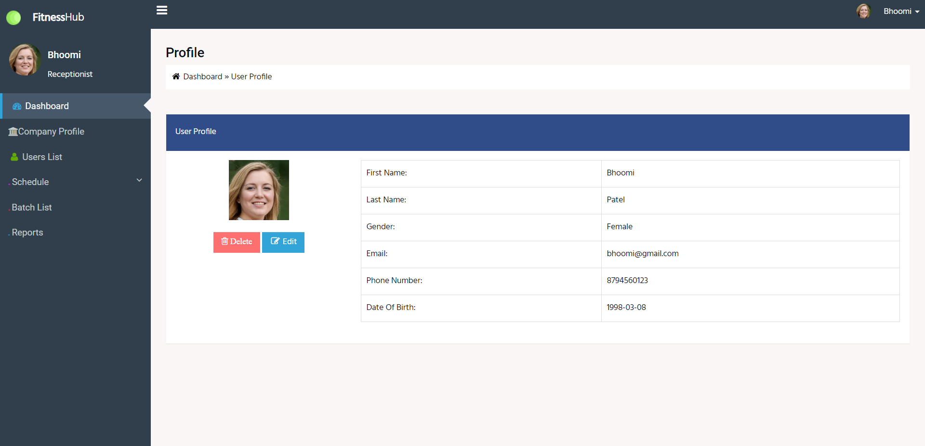
Manage profile:
Receptionist can manage his/her profile .

Slide 57

Manage profile:
Receptionist can update/delete his/her profile .

Slide 58

Change Password:
Receptionist can change password.

Slide 59
REPORTS :
Customer Report
Trainer Report
Attendance Report
Customer wise attendance
Trainer wise attendance

Slide 60
NUTRITIONIST

Slide 61

NUTRITIONIST DASHBOARD :

Slide 62

Company Profile:
Nutritionist can view company profile.

Slide 63

User List:
Nutritionist can view customer list to upload a diet chart for customer.

Slide 64

Customer List:
Nutritionist can view measurement list to upload a diet chart for customer.

Slide 65

Diet Chart:
Nutritionist can upload diet chart for customer.

Slide 66

Diet Chart:
Nutritionist can upload diet chart for customer.

Slide 67

Diet Chart:
Nutritionist can view diet chart uploaded for customer.

Slide 68

Food Detail:
Nutritionist can add/update/delete food details.

Slide 69

Food Detail:
Nutritionist can add/reset food details.

Slide 70

Food Detail:
Nutritionist can edit food details.

Slide 71

Manage profile:
Nutritionist can manage his/her profile .

Slide 72

Manage profile:
Nutritionist can update/delete his/her profile .

Slide 73

Change Password:
Nutritionist can change password.

Slide 74
REPORTS :
Customer Measurement Report
Diet Report
Food details report

Slide 75
CUSTOMER

Slide 76

HOME :

Slide 77


Slide 78

ABOUT US :

Slide 79


Slide 80


Slide 81


Slide 82

CLASSES AND SERVICES

Slide 83


Slide 84


Slide 85


Slide 86

CONTACT US :

Slide 87
THANK YOU

